Slide 1
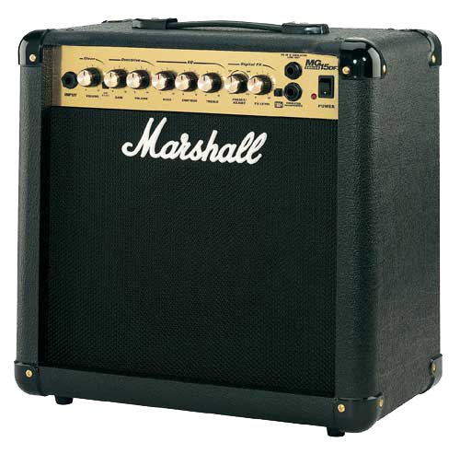
Amp Up ES and JHS Lessons

Slide 2
JUNIOR HIGH
Multiple Schools
JHS vs Elementary
JTEs
Speech Contest
Self Introduction Lesson

Slide 3
ELEMENTARY
HRTs
Communication
Lead Teaching
Be Proactive
Vocab and Games

Slide 4
LESSON PLANNING
Stay Organized!
Build on Past Lessons
Use your Strengths
Kindergarten
Backup Games!

Slide 5
EVERYTHING ELSE
Questions??
englipedia.net
oitajets.weebly.com

