Slide 2
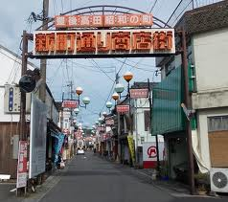
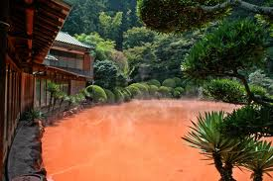
WHAT WHERE HOW OITA?

Slide 3
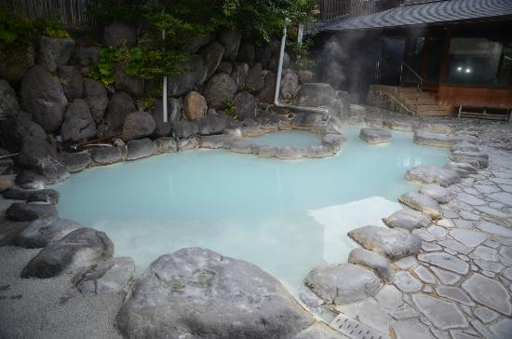
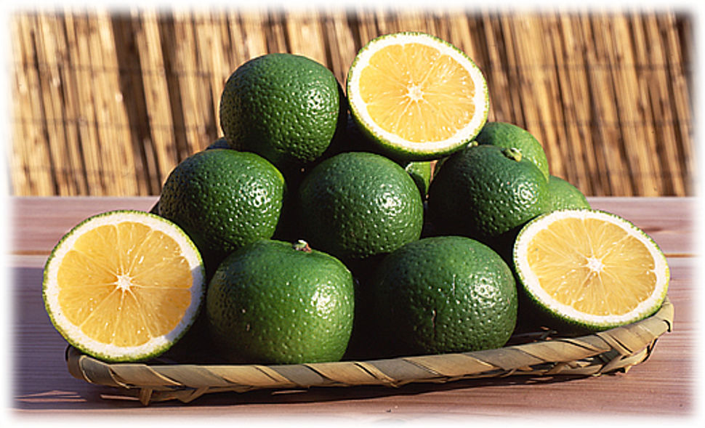
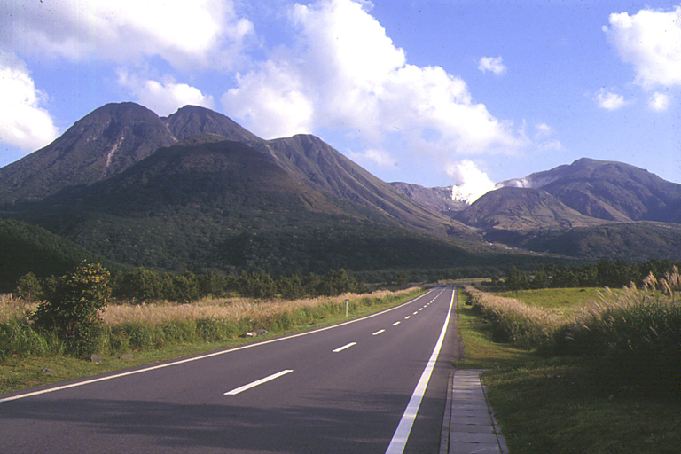
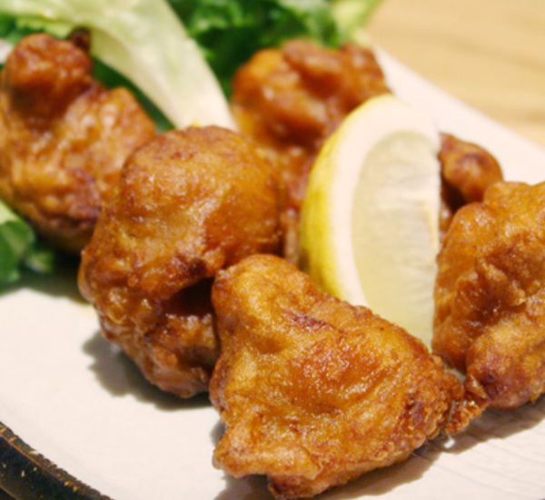
OITA!!!

Slide 4
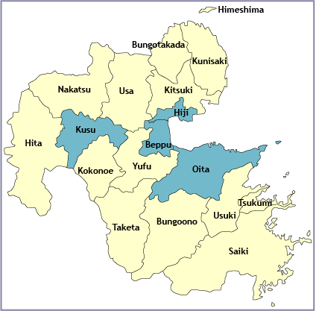

Slide 5
Shopping
Homewide （ホームワイド）
Daiso （ダイソー）
Don Quixote (ドンキホテ）(donki)
Trial （トライアル）
Uniqlo
Hard off (ハードオフ)
Nitori (ニトリ）
Kaldi
Park Place (パークプレス）
Wasada Town （トキハわさだタウン）
Yume Town (Beppu)

Slide 6
Entertainment Oita City
Heat Devils
Oita Trinita
Movie theatres in Oita
http://hlo.tohotheater.jp/net/schedule/055/TNPI2000J01.do
http://t-joy.net/site/oita/schedule/index.php
字幕
Round One
Wasada Town
Park Place

Slide 7
Entertainment Inaka
Karaoke
Find local restaurants
Find local bars
Explore your area
Festivals
Other local events/concerts
Castles

Slide 8
Not too far…
Ikea（kokura)
2 Costcos (kokura and Fukuoka)
Riverwalk mall in Kokura
H&M/ Forever 21 in Hakata
Kumamoto
Miyazaki

Slide 9
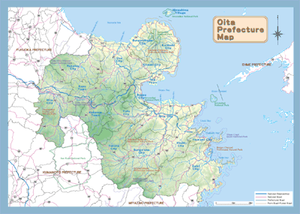
Traveling in Oita
Car
Most roads are free
Toll roads
ETC card/reader
Oita airport express is free
Parking at Donki until 3am
Other paid parking
Google maps

Slide 10
Life without a car
Amazon.jp ( can pay and pick up at conbini)
The Flying pig
The meat guy
Tengu natural foods (can pay in person)
Amazon for food
Trains
Google Maps
Hyperdia
“Japan Trains” app
Buses
Oita bus navi ( busnavi-oita.com)

Slide 11
Oita Bus navi http://www.busnavi-oita.com/

Slide 12
Google Maps

Slide 13
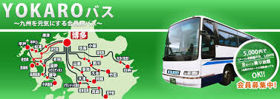
Yokaro
7000 yen per year
Unlimited rides on the bus
Book in advanced online
Only 2 buses a day

Slide 14
Getting by with little Japanese
Rikaichan
Google Chrome
Ask for help
Dictionaries for smartphones
Japanese (JED)
Midori
Imiwa
Chinese character panel
Study
Memrise
Anki
Flashcards Deluxe
Remembering the Kanji

Slide 15
Getting involved
Join in School clubs
Ask about other clubs or classes in town
Join a sports team
Explore your own area
Take Japanese classes and self study
Explore your own hobbies, create new hobbies

Slide 16
Hobbies
Cooking/Baking
Using a toaster oven
Substitute materials
experiment
Music
Photography
Sports
Crafting
Writing
Art (painting/sketching etc.)

Slide 17
Defeating Culture shock/ Homesickness
Keep in contact with friends and family
Keep busy in your daily life
Buy foreign foods
Make foods that you miss
Embrace the JET community
Try to make new friends from your town, your school etc.
Be easygoing
Don’t get held up by little inconveniences

Slide 18
BECAUSE JAPAN!

Slide 19
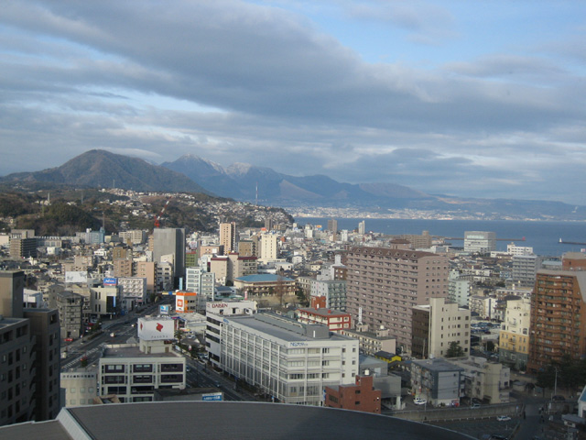
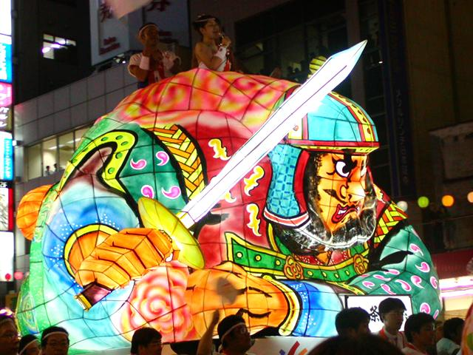
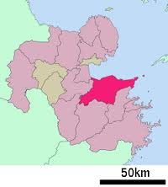
Oita City
Oita is the main city of Oita prefecture. Like most cities it has:
Shopping. (Wasada Town and Park place; Don quixote; etc)
Nightlife (Miyako-machi; izakayas; karaoke bars; PEI)
Discount stores ( Hi hirose, Hard Off; etc)
Tourist attractions/festivals:
Oita Castle
The old bank
Funai Pacchin festival ( Early August)

Slide 20
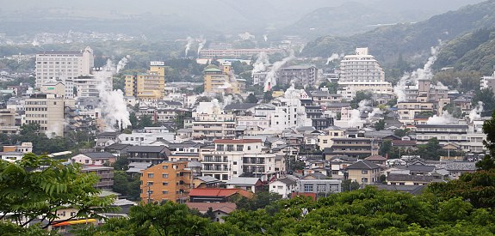
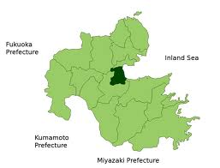
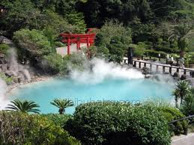
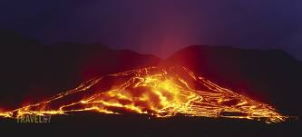
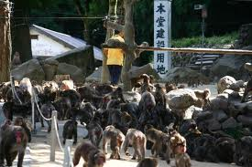
Beppu
Yume Town shopping.
Nightlife (50’s dance club)
Hundreds of onsens
Takasakiyama (aka monkey mountain)
Beppu Hells (Jigoku)
Beppu Aquarium
Spa Beach
Festivals (Mt Ogi Fire Festival (April) ; Hatto Onsen Festival (April); Summer festival (July); Christmas FANTASIA Festival (Christmas time))

Slide 21
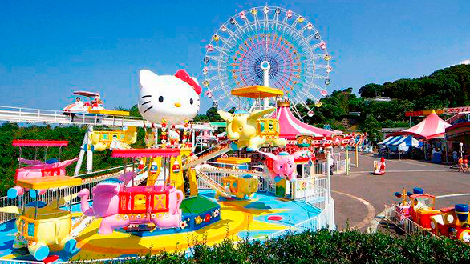
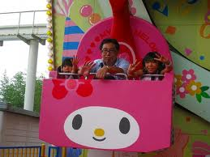
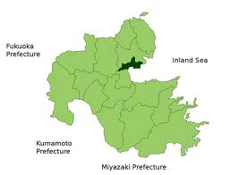
Hiji
Harmony land
Beautiful Coastline
Special fish you can
only find and eat in Hiji.

Slide 22
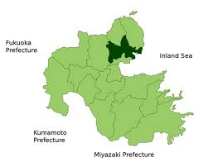
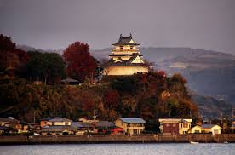
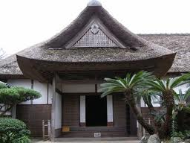
Kitsuki
Kitsuki Castle
Samurai House
Historical museum
Kimono rental for the day

Slide 23
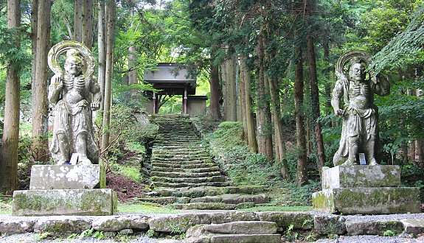
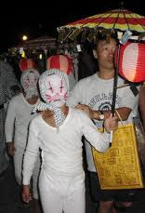
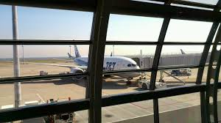
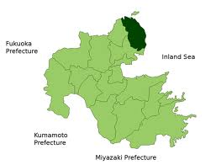
Kunisaki
Futago-ji
Gyonyu Dam
Lake Taro
Furuichi bathing beach
Oita Airport
Himeshima island (Kitsune odori festival
( August 14th)

Slide 24
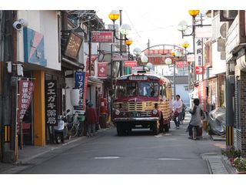
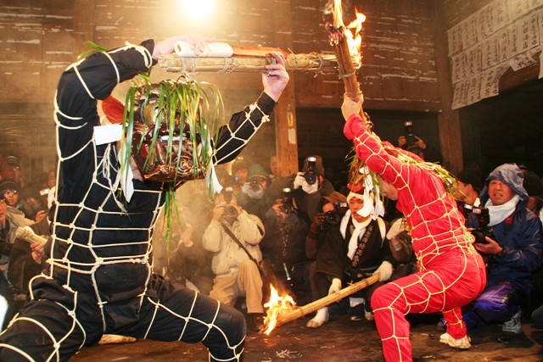
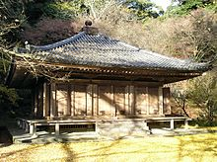
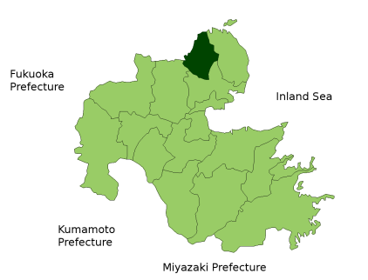
Bungotakada
Showa no machi
Fukiji (built in 718)
Tennenji
Kumano magaibutsu
Tashibu rice fields
Obon festival (August 18th)
Naked man festival (November 22-24th)
Horan Enya festival (January)
Shujo onie festival
(February)
Soba!

Slide 25
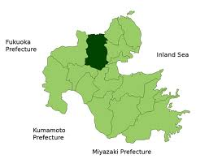
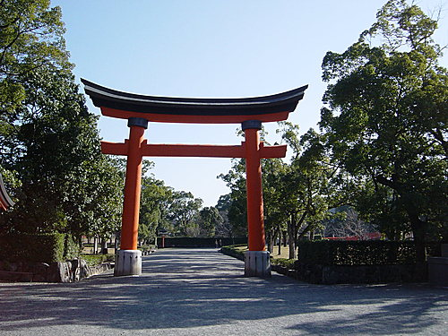
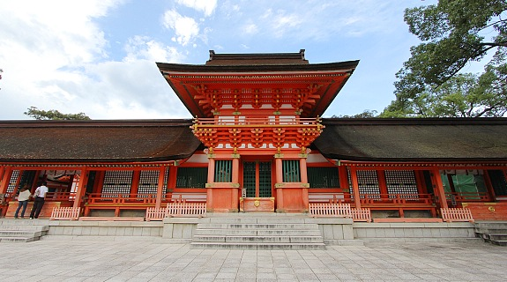
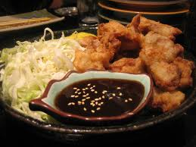
Usa
Usa Shrine
Higashi shiiya falls
African Safari
Ajimu wine
Karaage

Slide 26
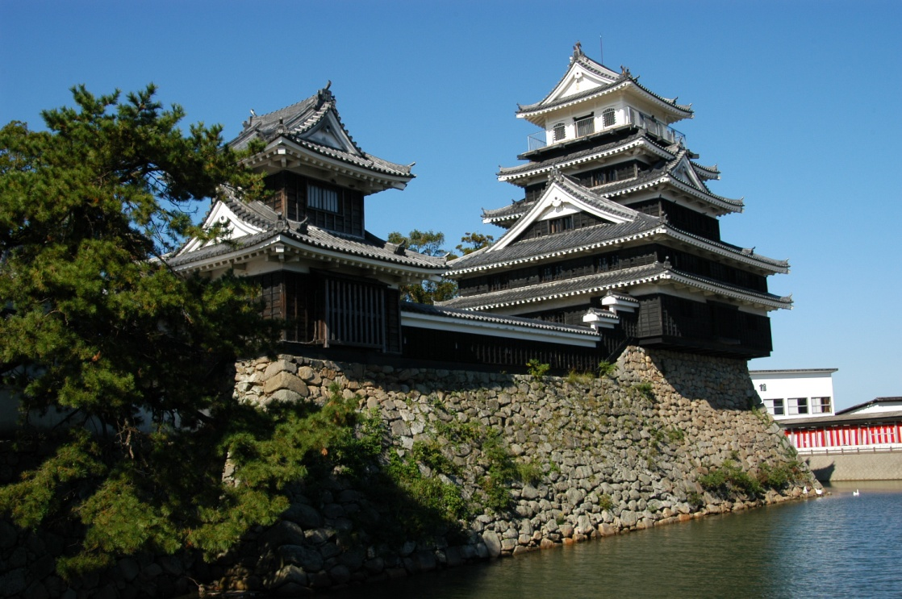
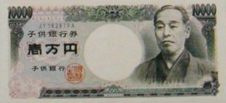
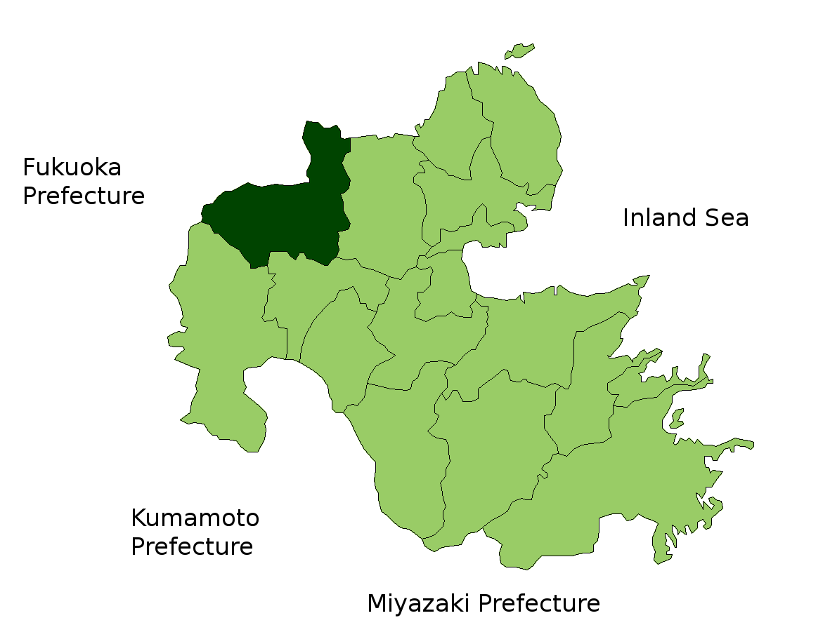
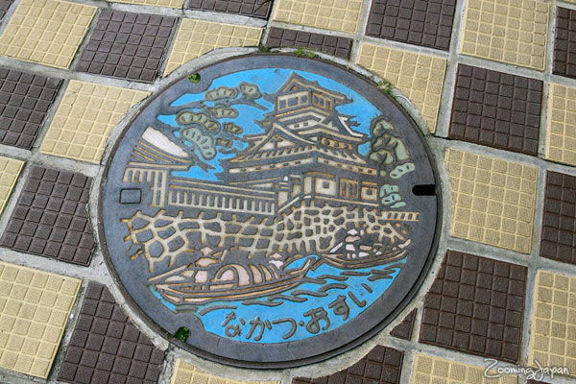
Nakatsu
Yume town
Nakatsu castle
More karaage!
Fukuzawa Yukichi’s
Hometown (the guy on the 1 man bill)
Ao no Doumon
Karaage festival
(September
21-22nd)

Slide 27
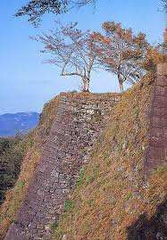
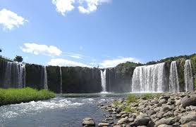
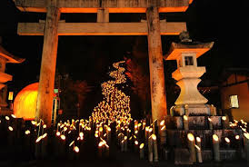
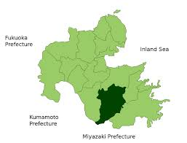
Bungo Ono/Taketa
Mt. Kuju
Lantern Festival
Ice cream scavenger hunt
Onsen
Oka Castle
Harajiri Falls

Slide 28
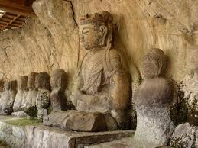
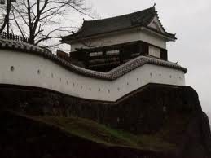
Usuki, Saiki, Tsukumi
Usuki Castle
Stone Buddha
Fishing
Usuki Fire festival (late August)
Firework Festival
Fireflies in June

Slide 29
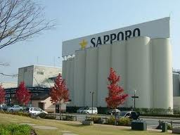
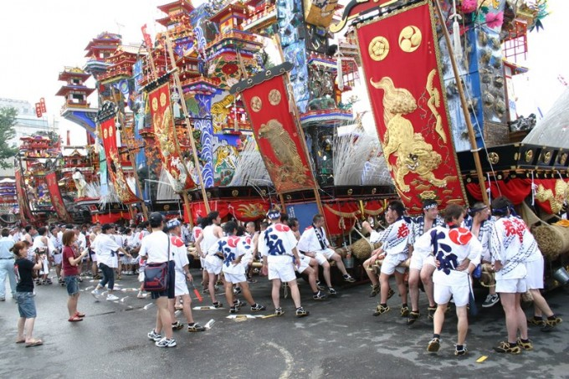
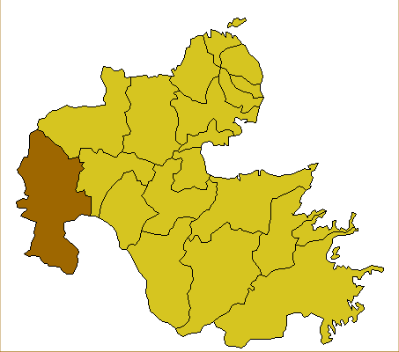
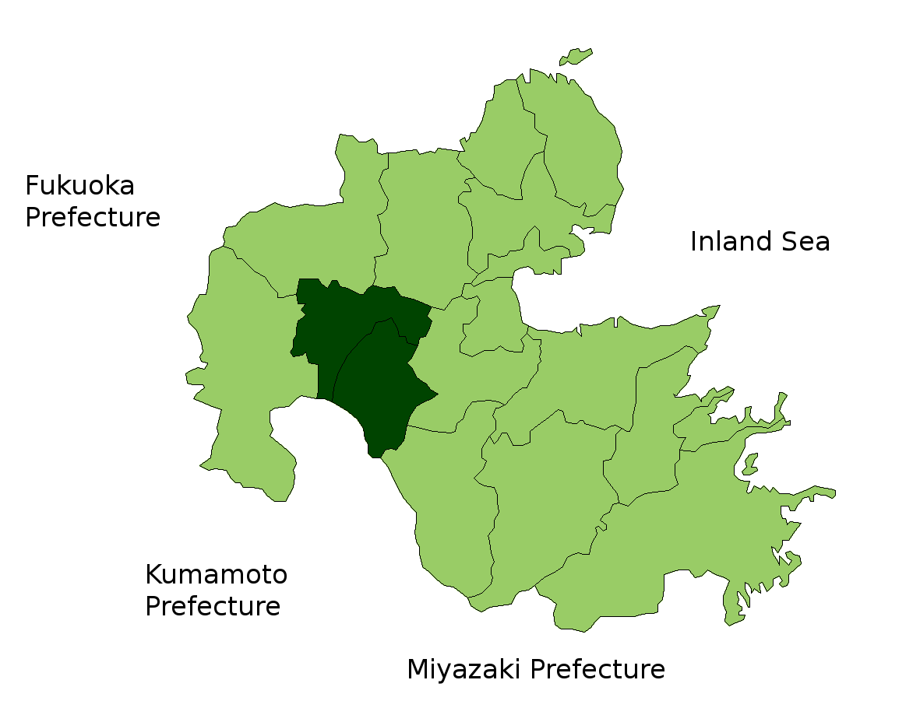
Hita, Kusu area
Sapporo Beer Factory
Hita Gion Festival
Onta Pottery Village

